Slide 1
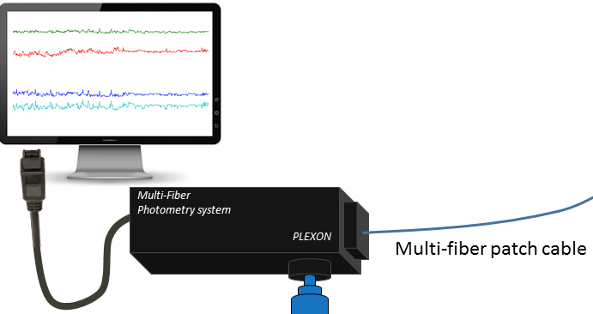

Slide 2
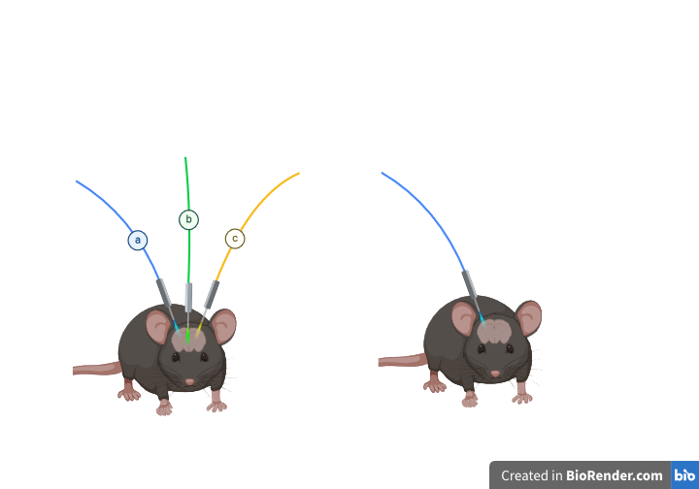
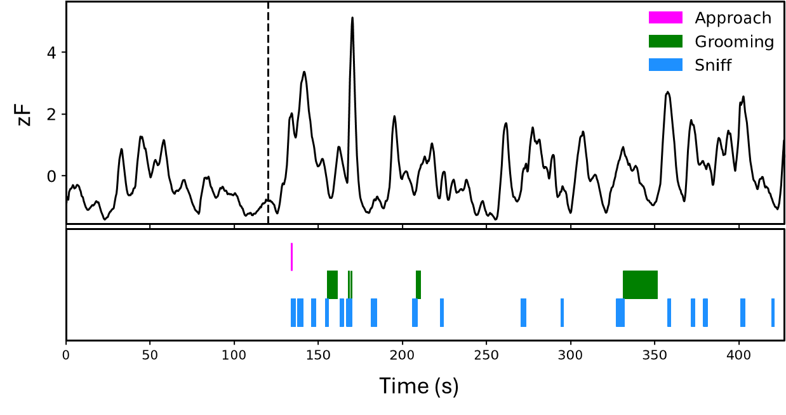
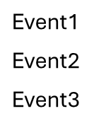
Fiber Photometry
System
Stimulus
Presented
Multi-fiber
patch cable
Neural Signal
Fiber optic
cannula
peri-event
peri-baseline
Events
Resulting GCaMP signal

Slide 3
Surgically prepare subject(s)
Attach to recording device

Slide 4
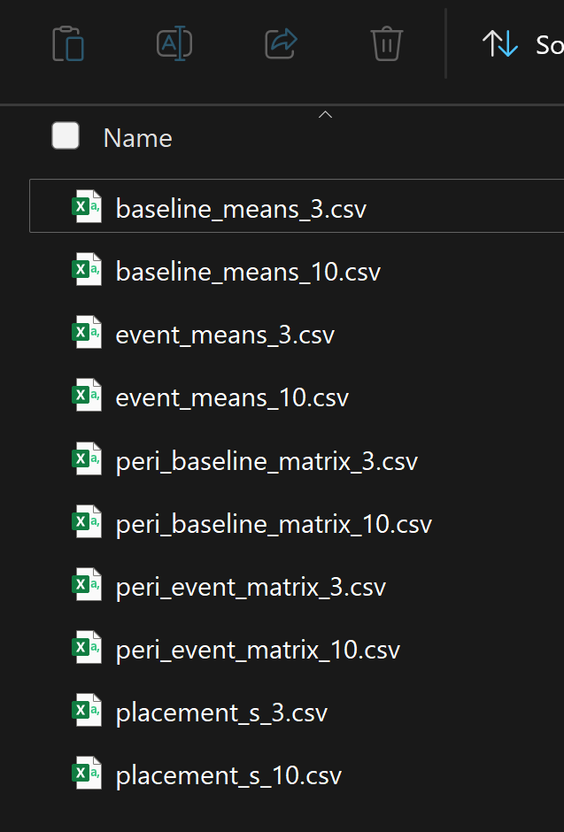
/project_home/Behaviors/during/Event1

Slide 5
Separate LED signals (470 nm and 410 nm)
Fit, normalize, and smooth resulting trace.
Temporally align event scorings with photometric data
Identify event onsets
Extract related photometric data
Save to DataFrame

Slide 6
470 nm wavelength excites ‘green’ thus is able to measure resulting calcium fluctuations. “410nm” LED which is outside the range of excitation is used as the control for motion or faulty connection.

Slide 7
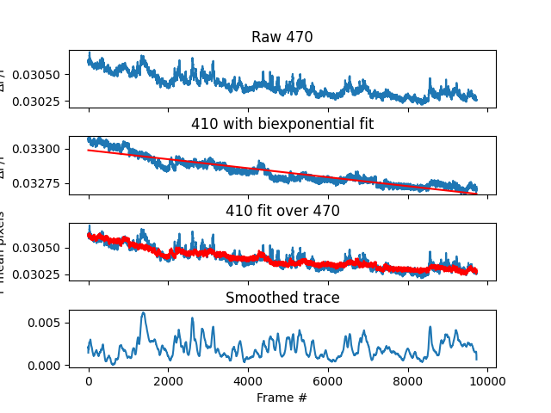

Slide 8
Raw Means (zF trace)
Animal ID_Event1 | Event baseline | Event1 | Animal ID_Event2 | Event2 baseline | Event2
10 | 0.237185592 | 0.62647296 | 10 | -0.23597 | 3.898863
210 | 0.6286254 | 0.52124428 | 210 | -1.15676 | 3.835316
211 | 0.138647504 | 0.0021053 | 211 | 0.040474 | -0.68842
23 | 0.303941414 | 0.14241895 | 23 | 1.775338 | 3.754161
27 | 0.744645565 | 0.37076624 | 27 | 0.412623 | 3.144957
33 | -0.21897671 | -0.60419 | 3 | 0.283668 | 5.281562
37 | -0.1895812 | 0.06009613 | 310 | -0.57432 | 4.961736
 |  |  | 33 | 0.570478 | 3.355841
 |  |  | 37 | 1.033783 | 2.52302
 |  |  | 7 | 0.123744 | 1.880313
Provided Outputs:
Raw Means
Area Under the Curve
%Change
Peri-Zscore
Saves event values by individual events and averaged by trial.

Slide 9
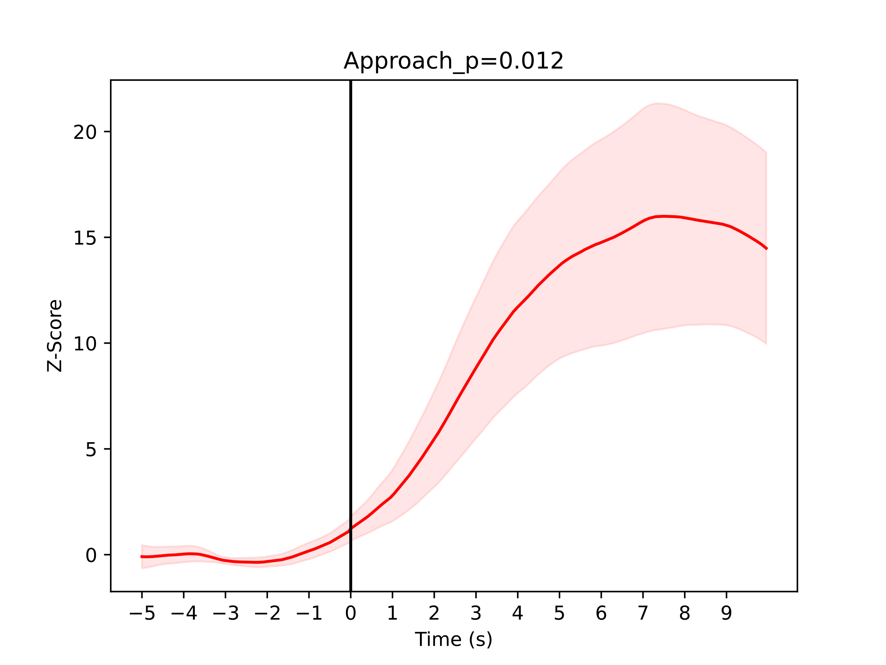
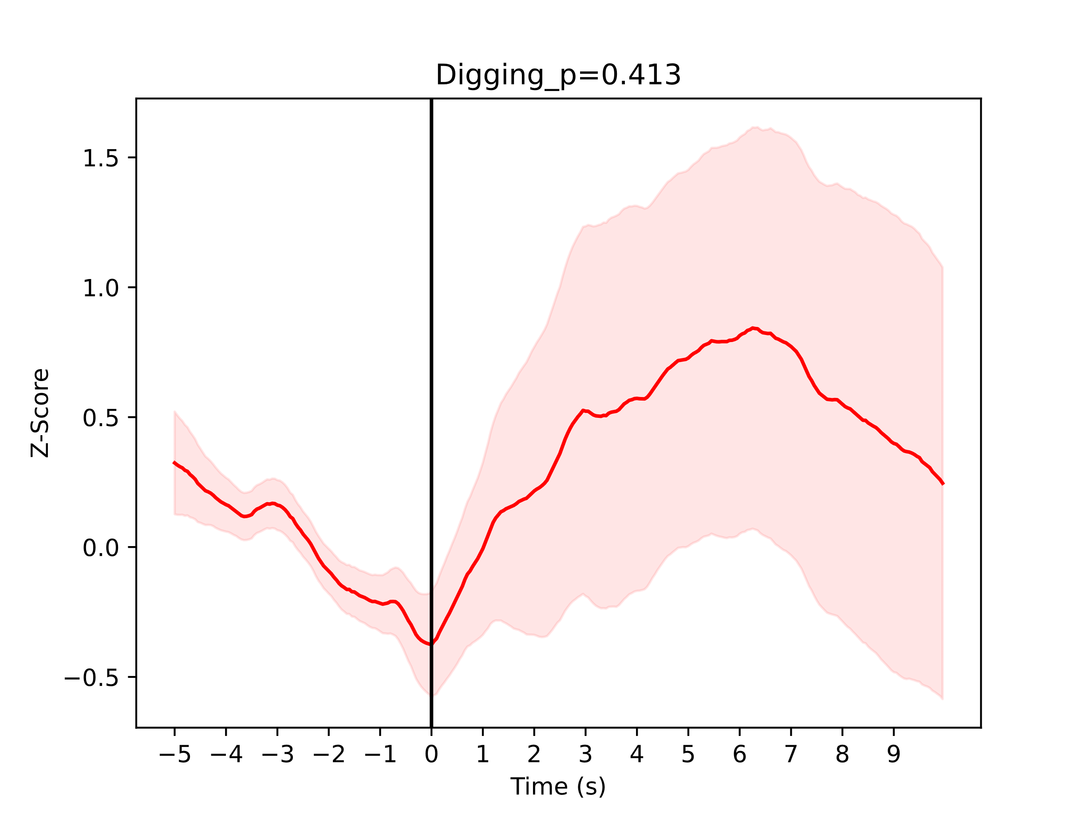
Preliminary plots

